Slide 1
Text Categorization/Classification ________________________ Deep Learning

Slide 2
The problem of (Text) Classification/Categorization
Theoretical: how can objects be differentiated?
Practical: what models & algorithms work well for differentiating among classes of objects?
Plan for the lecture:
Look at a few motivating examples of categorization
Define the problem formally for texts
Cover simple two methods for categorization in some detail
K-NN and Naïve Bayes
These methods form the building blocks of other classification models
Look at how these methods perform and what they learn
Classification using Deep Leaning
Lab on Deep Learning and conventional algorithms.

Slide 3
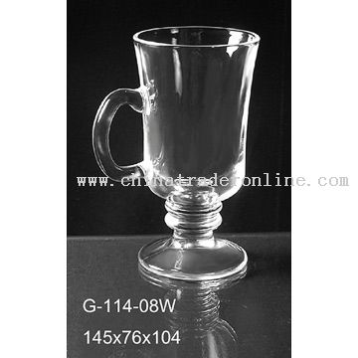
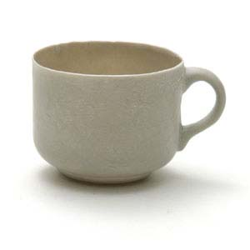
Conceptual categorization
Identify the features for classification into Cup and Glass

Slide 4
Email classification: Is this spam?
From: "" <takworlld@hotmail.com>
Subject: real estate is the only way...
Anyone can buy real estate with no money down
Stop paying rent TODAY !
There is no need to spend hundreds or even thousands for similar courses
I am 22 years old and I have already purchased 6 properties using the
methods outlined in this truly INCREDIBLE ebook.
Change your life NOW !
=================================================
Click Below to order:
http://www.wholesaledaily.com/sales/nmd.htm
=================================================
Notes:
Features would come from the content as well as email attributes such as the address and urls in the email.

Slide 5
Text Categorization Examples
Assign labels to each document or web-page:
Labels are most often topics such as Yahoo-categories
e.g., "finance," "sports," "news>world>asia>business"
Labels may be genres
e.g., "editorials" "movie-reviews" "news“
Labels may be opinion
e.g., “like”, “hate”, “neutral”
Labels may be domain-specific binary
e.g., "interesting-to-me" : "not-interesting-to-me”
e.g., “spam” : “not-spam”
e.g., “contains adult language” :“doesn’t”

Slide 6
Shopping on the Web
Suppose you want to buy a cappuccino maker as a gift
try Google for “cappuccino maker”
try Yahoo! Shopping for “cappuccino maker”

Slide 7
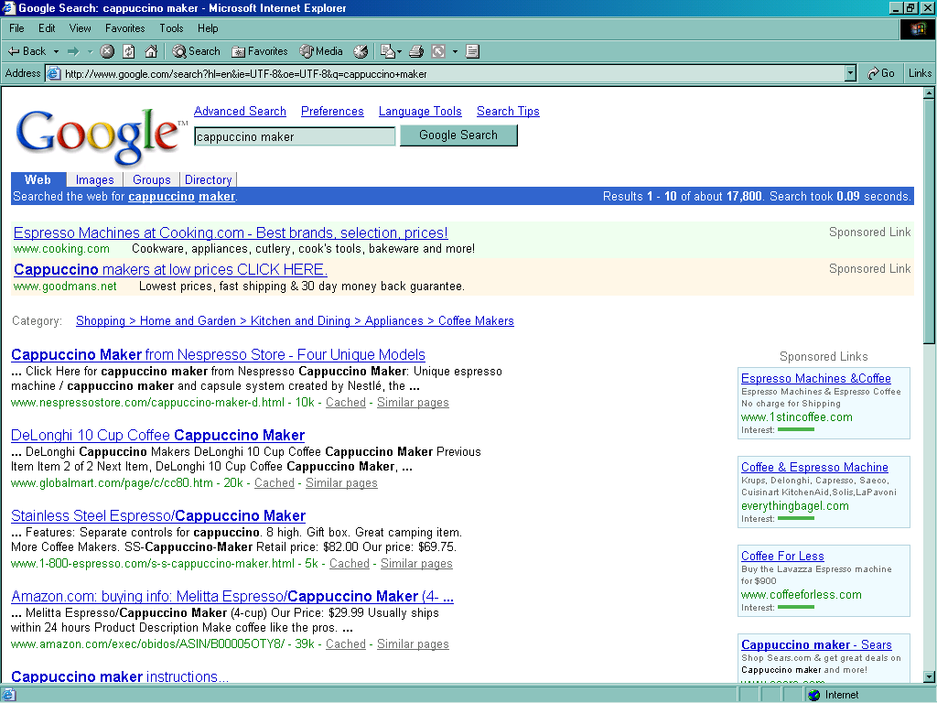
Notes:
You can get to a Google hierarchy indirectly if you note the
“Shopping > Home and Garden ...” link.

Slide 8
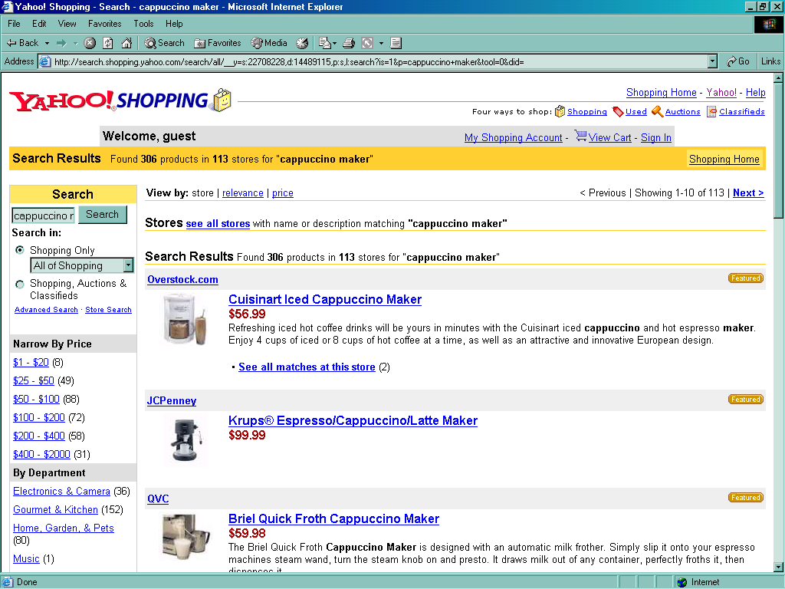

Slide 9
Observations…
Broad indexing & speedy search alone are not enough.
Organizational view of data is critical for effective retrieval.
Categorized data are easy for user to browse.
Category taxonomies become most central in well-known web sites (Google, Bing, Yahoo!, Lycos, ...).

Slide 10
Some Text Categorization Applications
Web pages organized into category hierarchies
Journal articles indexed by subject categories (e.g., the Library of Congress, MEDLINE, etc.)
Patents archived using International Patent Classification
Patient records coded using international insurance categories
E-mail message filtering
News events tracked and filtered by topics
Blogs filtered by topics, sentiments etc.

Slide 11
Approaches to Text Categorization (emphasizing the “k-Nearest Neighbor approach” and Naïve Bayes approach)

Slide 12
Key Components of Nearest Neighbor
“Similar” item: We need a functional definition of “similarity” if we want to apply this automatically.
How many neighbors do we consider?
Does each neighbor get the same weight?
All categories in neighborhood? Most frequent only? How do we make the final decision?

Slide 13
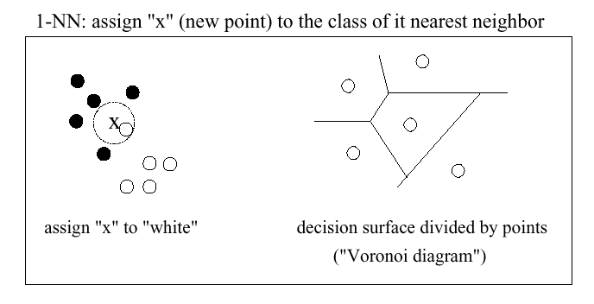
1-Nearest Neighbor (graphically)

Slide 14
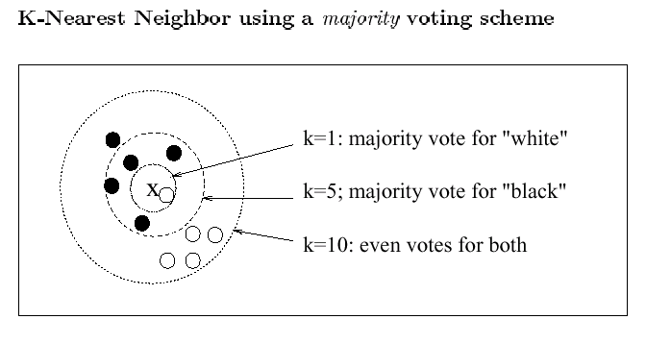
K-Nearest Neighbor using a majority voting scheme

Slide 15
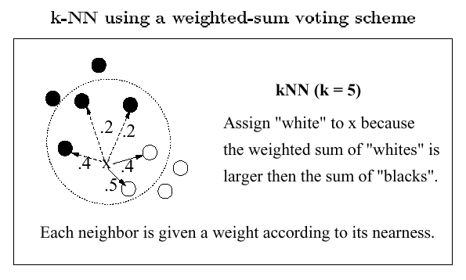
K-NN using a weighted-sum voting Scheme

Slide 16
kNN for Text Categorization (Yang, SIGIR-1994)
Represent documents as points (vectors).
Define a similarity measure for pairwise documents.
Tune parameter k for optimizing classification effectiveness.
Choose a voting scheme (e.g., weighted sum) for scoring categories
Threshold on the scores for classification decisions.

Slide 17
Possible Similarity Measures
Cosine similarity
Euclidean distance
Jaccard Distance
Kernel functions
Kullback-Leibler distance (distance between two probability distributions)

Slide 18
NB Classifier parameter estimation
P(c_{j})
Can be estimated from the frequency of classes in the training examples.
P(x₁, x₂,…..x_{n} | c_{j})
Could only be estimated if a very large no. of training examples was available

Slide 19
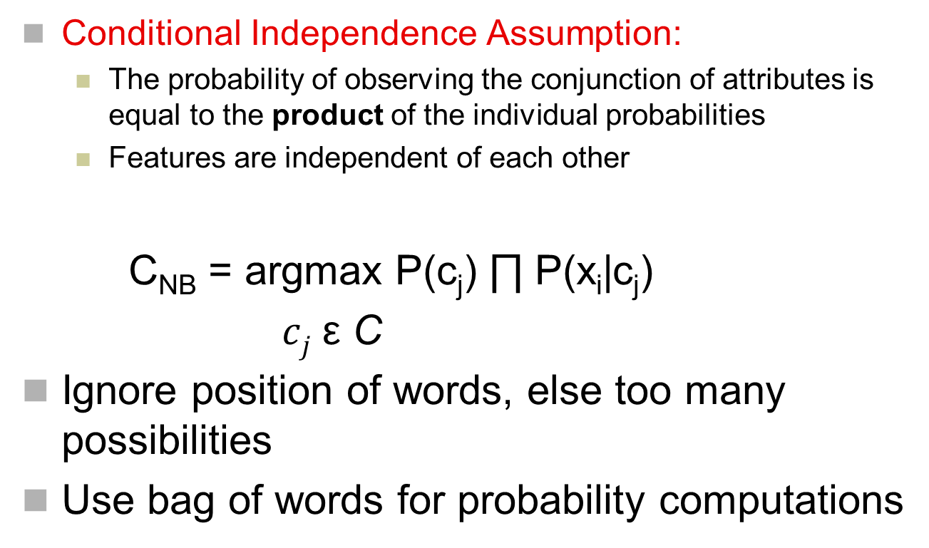
NB Assumptions

Slide 20
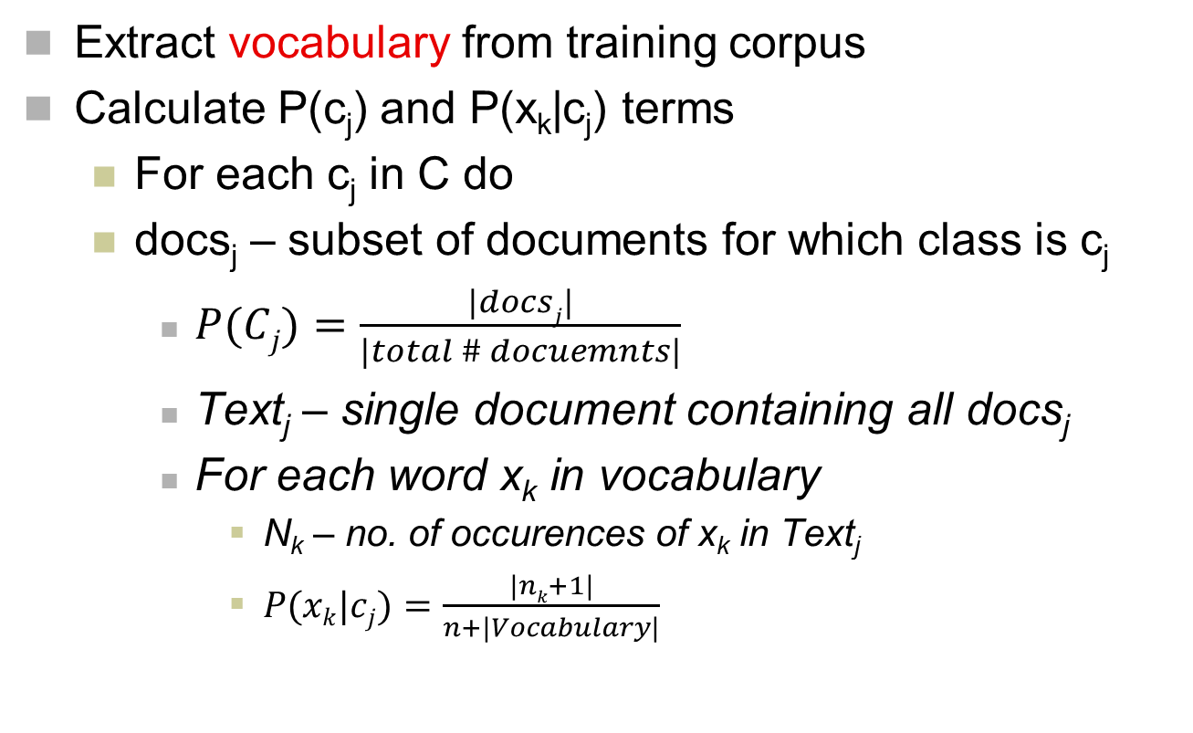
Training a NB classifier

Slide 21
Naive Bayes is Not So Naive
Naïve Bayes: First and Second place in KDD-CUP 97 competition, among 16 (then) state of the art algorithms
Goal: Financial services industry direct mail response prediction model: Predict if the recipient of mail will actually respond to the advertisement – 750,000 records.
Robust to Irrelevant Features
Irrelevant Features cancel each other without affecting results
Instead Decision Trees can heavily suffer from this.
Very good in domains with many equally important features
Decision Trees suffer from fragmentation in such cases – especially if little data available
A good dependable baseline for text classification (but not the best)!
Optimal if the Independence Assumptions hold: If assumed independence is correct, then it is the Bayes Optimal Classifier for the problem
Very Fast: Learning with one pass over the data; testing linear in the number of attributes, and document collection size
Low Storage requirements

Slide 22
Alternative counting scheme – TF-IDF
Term frequency-inverse document frequency
A statistical measure used to evaluate how important a word is to a document in a collection or corpus (or a category)
The importance increases with frequency but is offset by the frequency of words in the corpus.
A simple ranking function can be to sum up the ti-idf for each query term.
Can also be used for stop word filtering. That is, discard the lowest tf-idf terms.

Slide 23
Approaches to Automated Text Categorization
Decision trees
Naïve Bayes
K nearest neighbour
Perceptron
Support Vector Machines
CNN
Many others…
Notes:
Note that nearly all of these methods were invented before these dates. These dates indicate their application to text categorization.

Slide 24
Evaluation Methodology and Performance Metrics

Slide 25
Classification Performance Measures
Given n test documents and m classes in consideration, a classifier makes n × m binary decisions. A two-by-two contingency table can be computed for each class.
Referred to as confusion matrix
 | Machine Yes | Machine No
Ground Truth Yes | TP | FN
Ground Truth NO | FP | TN

Slide 26
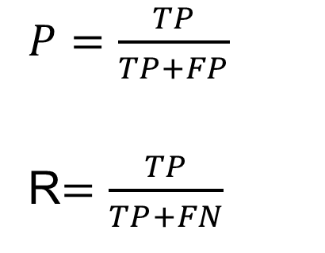
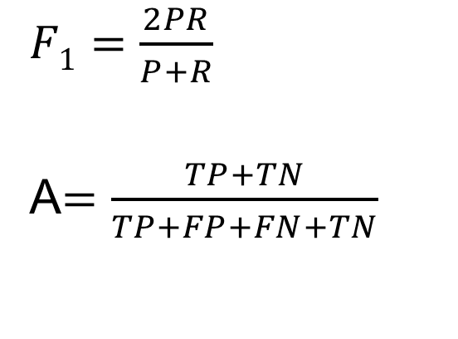
Classification Performance Measures
 | Machine Yes | Machine No
Ground Truth Yes | TP | FN
Ground Truth NO | FP | TN
P = Precision
R = Recall
F₁ = F-value or F-score
A = Accuracy
What about more than 2 classes?

Slide 27
Evaluating Results
Results on training corpus might not be mirrored in the real world.
Want to avoid overfitting.
Need separate test data. Hold out 10–20% of the corpus.
N-fold cross-validation
Leave-one-out cross-validation
Separate development/train and validation and test sets.
Need a measure of performance and comparison to baseline.
Why?

Slide 28
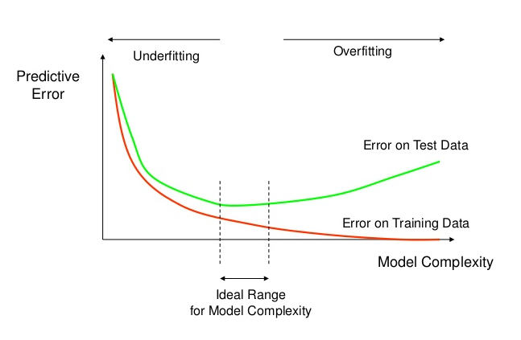
Overfitting/Underfitting

Slide 29
Baseline performance
Baseline: The minimum performance level that you’re trying to improve on.
Could be performance of competing system.
Could be performance of dumb but easy method:
Random choice, most-frequent answer, very simple heuristic, ...
Comparison should be made on the same test data for results to be fully meaningful.
Gold standard comparison – compared with best achieved results.
Leaderboard

Slide 30
Deep Learning

Slide 31
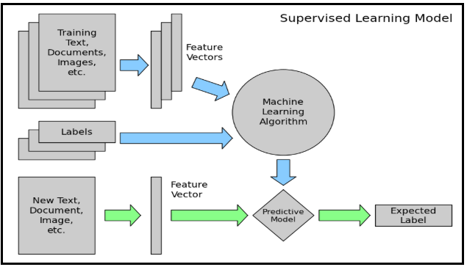
Classification using Deep Learning

Slide 32
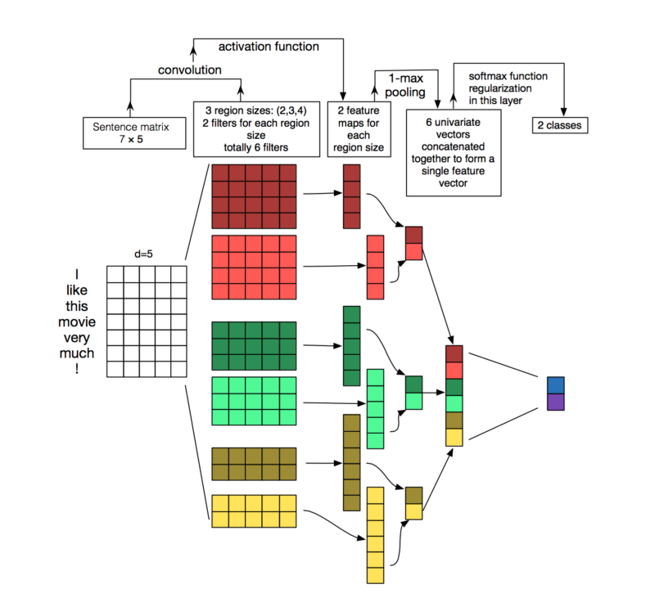
Convolutional Neural Network (CNN)

Slide 33
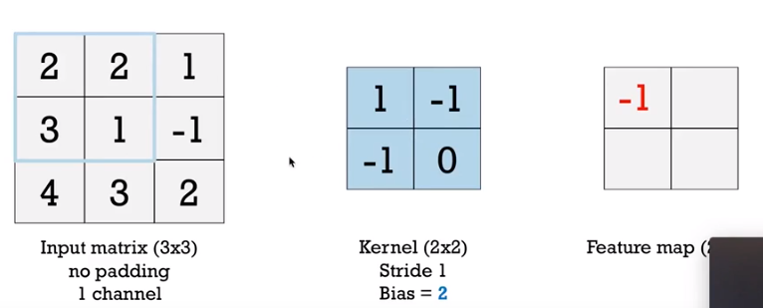

Matrix Convolution
Cross channel sum of the receptor region with a kernel/mask computed over a sliding window given a stride (and padding) plus a bias term.

Slide 34
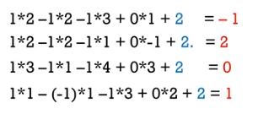
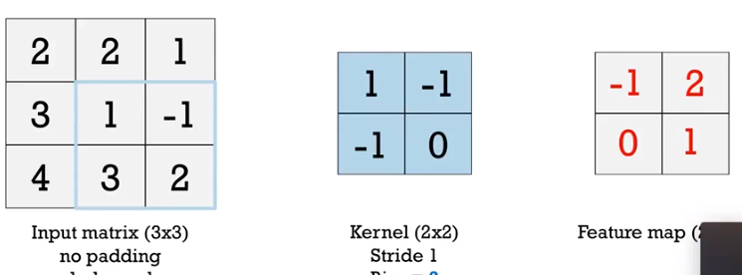
Matrix Convolution
Cross channel sum of the receptor region with a kernel/mask computed over a sliding window given a stride (and padding) plus a bias term.

Slide 35
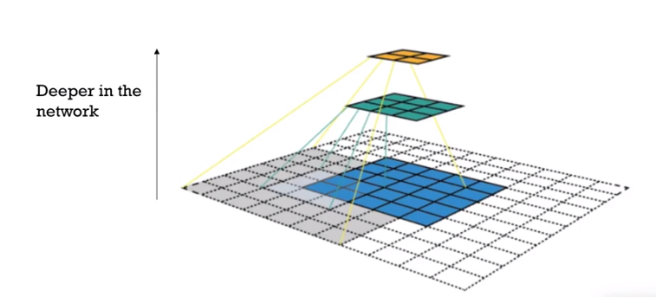
Convolution to reduce dimensions
To prevent combinatorial explosion.

Slide 36
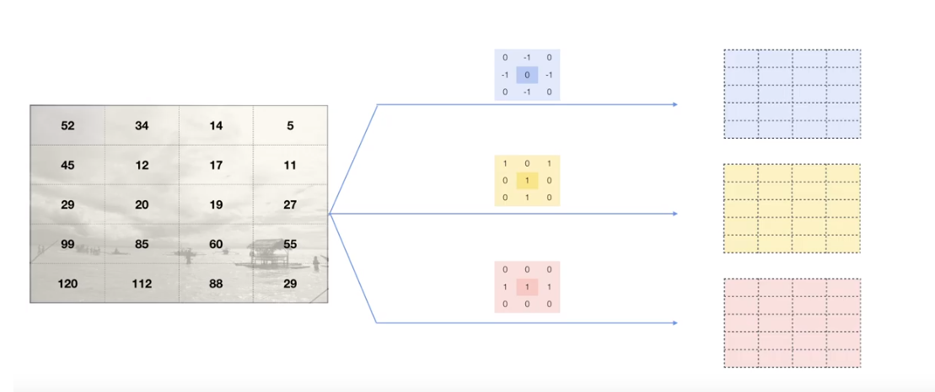
3 convolutions with different kernels

Slide 37
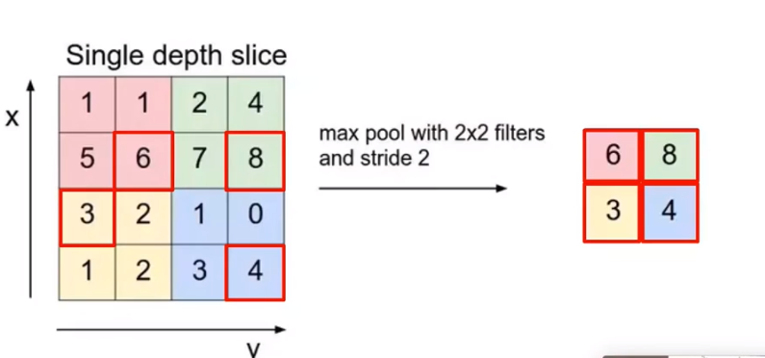
Max pooling
Picks the biggest number from a window/region

Slide 38
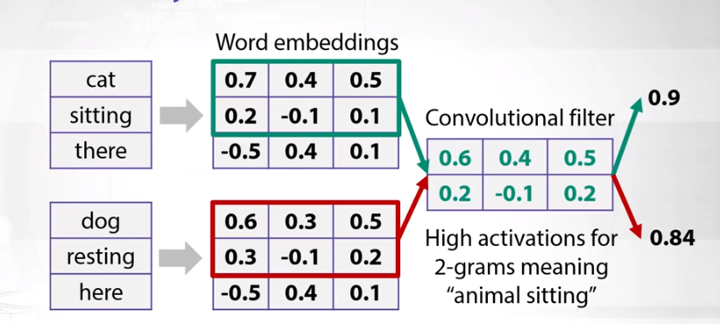
Convolve to lower dimensional matrix

Slide 39
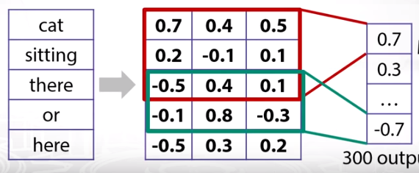
Max pooling

Slide 40
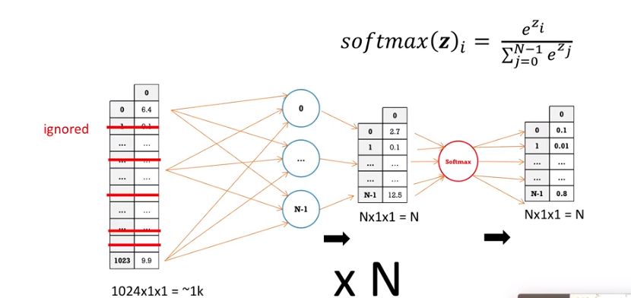
Fully connected neural net at the end.
Flattened matrix, Dropout, softmax for n categories

Slide 41
GloVe: Global Vectors for Word Representation
GloVe is an unsupervised learning algorithm for obtaining vector representations for words. Training is performed on aggregated global word-word co-occurrence statistics from a corpus, and the resulting representations showcase interesting linear substructures of the word vector space.
Can download the embedding to plug into CNN models instead of training your own.
https://nlp.stanford.edu/projects/glove/

Slide 42
Deep Learning Summary
Word embedding
N-grams
Sliding window
Strides
Kernels
Max pooling
Activation functions
Flattened matrix
Fully connected NN
dropout
Softmax function
Back propagation
Loss function

Slide 43
Demo Code
Text Classification Demo
CNN Demo
text_sentoken (data)
Classification_Data_Computers (data)

